Slide 1
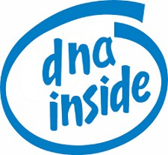

DNA
COMPUTING

Slide 2


PROBLEM
Computer chip manufacturers are furiously racing to make the next microprocessor that will topple speed records.Microprocessors made of silicon will eventually reach their limits of speed and miniaturization.
Scientists have found the new material they need to build the next generation of microprocessors: DNA they have the potential to perform calculations many times faster than the world's most powerful human-built computers.

Slide 3
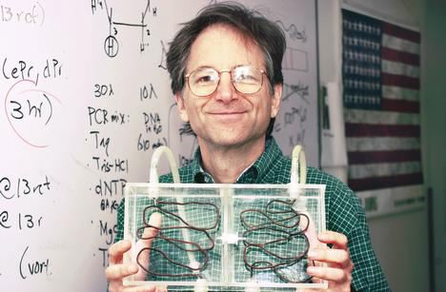
DNA COMPUTER
Adleman demonstrated and proof DNA as a form of computation, his article outlined how to use DNA to solve a well-known mathematical problem, called "traveling salesman" problem.
Basically a DNA computer is a test tube, with some of these DNA strands sticking together.These DNA are used to build logic gates analogous to digital logic in silicon; however, DNA are limited to 1, 2, and 3 input gates.

Slide 4

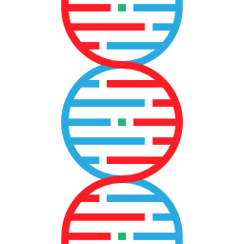
LOT OF DATA IN SMALL VOLUME

Slide 5
IT IS DURABLE

Slide 6
FOREVER YOUNG :v
#YOLO
DOES NOT GET OBSOLETE

Slide 7

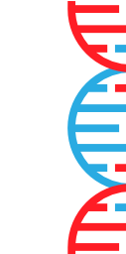
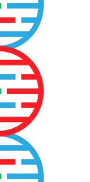



VARIOUS SEQUENCE MADE OF 4 TYPES OF MOLECULES
TO STORE DATA IT NEEDS TO BE CONVERTED FROM 0|1 TO THEIR ACGT EQUIVALENT.

Slide 8


THEN WE PUT SOME MARKERS TO IDENTIFY WHERE DATA BELONGS IN THE ORIGINAL SEQUENCE.
IT IS SYNTHESIZED INTO SEQUENCES OF DNA, FOR DECODING IT IS MADE A PROCESS CALLED PCR TO SELECT THE SEQUENCES OF THE FILES WE WANT TO READ. FINALLY WE CAN CONVERT INTO 0|1 AGAIN AND HAVE THE FILE AGAIN.

Slide 9


TRAVELING SALESMAN WITH DNA
1.-Strands of DNA represent the seven cities. Genetic coding is represented by the letters A, T, C and G. Some sequence of these four letters represented each city and possible flight path.

Slide 10


2.-These molecules are then mixed in a test tube, with some of these DNA strands sticking together. A chain of these strands represents a possible answer.

Slide 11


3.-Within a few seconds, all of the possible combinations of DNA strands, which represent answers, are created in the test tube.

Slide 12


4.-Adleman eliminates the wrong molecules through chemical reactions, which leaves behind only the flight paths that connect all seven cities.

